Slide 1

Database Systems: Design, Implementation, and Management Tenth Edition
Chapter 3
The Relational Database Model

Slide 2
Objectives
In this chapter, students will learn:
That the relational database model offers a logical view of data
About the relational model’s basic component: relations
That relations are logical constructs composed of rows (tuples) and columns (attributes)
That relations are implemented as tables in a relational DBMS

Slide 3
Objectives (cont’d.)
About relational database operators, the data dictionary, and the system catalog
How data redundancy is handled in the relational database model
Why indexing is important

Slide 4
A Logical View of Data
Relational model
View data logically rather than physically
Table
Structural and data independence
Resembles a file conceptually
Relational database model is easier to understand than hierarchical and network models

Slide 5
Tables and Their Characteristics
Logical view of relational database is based on relation
Relation thought of as a table
Table: two-dimensional structure composed of rows and columns
Persistent representation of logical relation
Contains group of related entities (entity set)

Slide 6
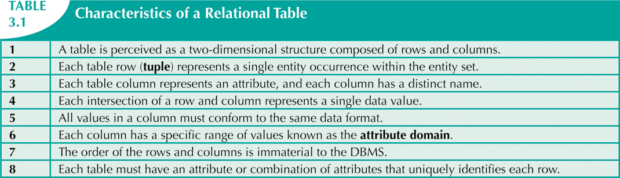

Slide 7
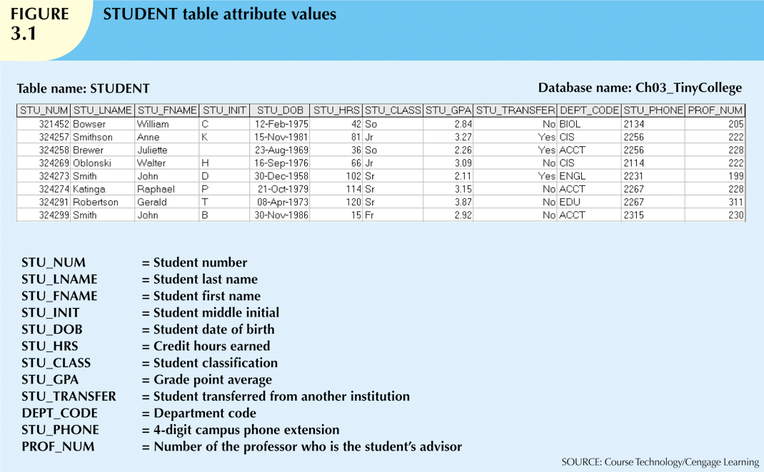

Slide 8
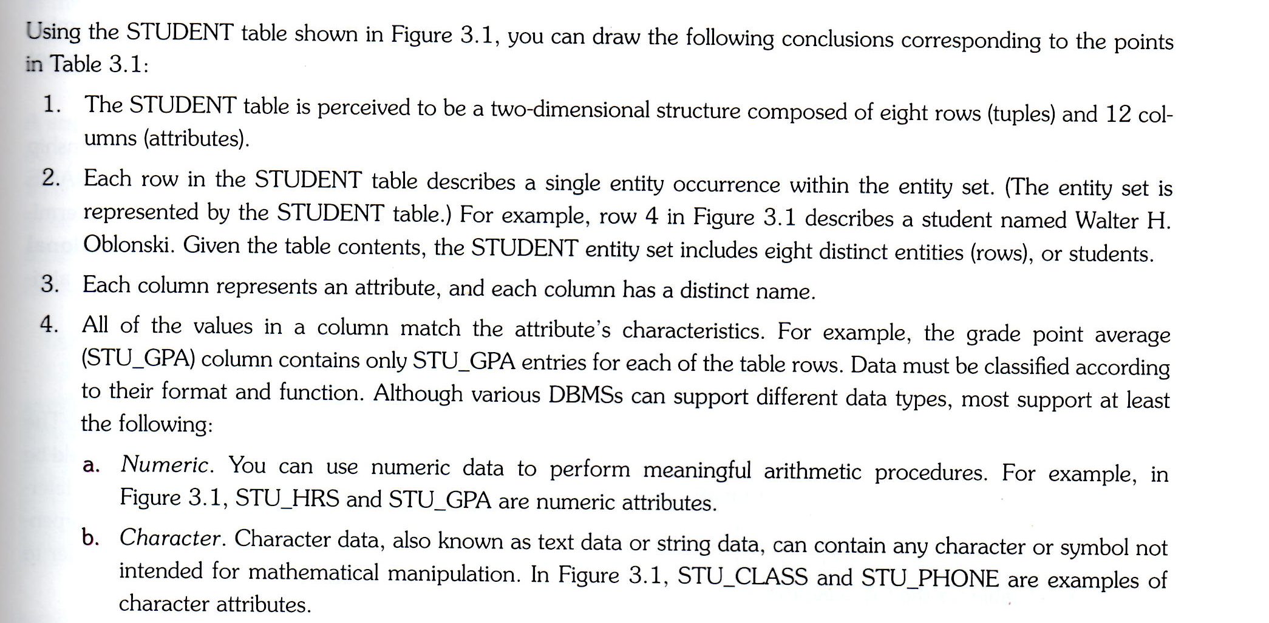

Slide 9
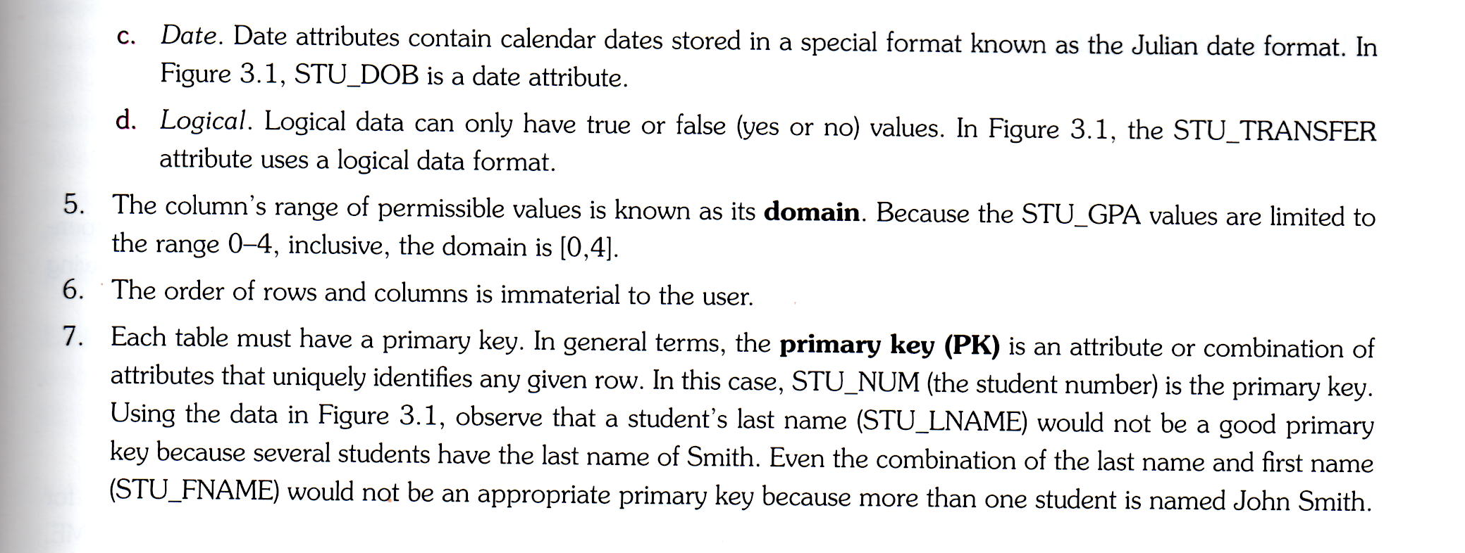

Slide 10
Keys
Each row in a table must be uniquely identifiable
Key: one or more attributes that determine other attributes
Key’s role is based on determination
If you know the value of attribute A, you can determine the value of attribute B

Slide 11
Keys
Functional dependence
Attribute B is functionally dependent on A if each value in column A determines one and only one value in coloumn B
STU_NUM-> STU_LNAME
STU_NUM is the determinant
STU_LNAME is the dependent
STU_NUM->(STU_LNAME, STU_FNAME,STU_GPA)

Slide 12
Types of Keys
Composite key
Composed of more than one attribute
Key attribute
Any attribute that is part of a key
STU_NUM->STU_GPA
(STU_LNAME,STU_FNAME,STU_INIT,STU_PHONE) ->STU_HRS
Superkey
Any key that uniquely identifies each row
STU_NUM i
(STU_LNAME,STU_FNAME,STU_INIT,STU_PHONE)

Slide 13
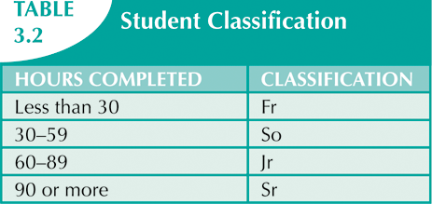
Types of Keys
In Table 3.2, student classification is based on hours completed
STU_HRS->STU_CLASS
The specific number of hours is NOT dependent on the classification.
A junior can have 62 hours or 84 hours

Slide 14
Types of Keys
Candidate key
A superkey without unnecessary attributes (minimal)
(STU_NUM,STU_LNAME) is a superkey but not a candidate key
The primary key is the candidate key chosen by the designer to be the primary means by which rows of the table are uniquely identified
(STU_LNAM E,STU_FNAME,STU_INIT,STU_PHONE)

Slide 15
Types of Keys (cont’d.)
To ensure entity integrity each row (entity instance) in the table has its own unique identity
Each primary key has two requirements:
All the values in the PK must be unique
No key attribute in the PK can contain a null
NULL
No value at all (not a zero or space)
Created when you hit the Enter or Tab key to move to the next entry without making an entry of any kind
Should be avoided in other attributes

Slide 16
Types of Keys (cont’d.)
NULL can represent:
An unknown attribute value
A known, but missing, attribute value
A “not applicable” condition
Can create problems when functions such as COUNT, AVERAGE, and SUM are used
Can create logical problems when relational tables are linked

Slide 17
Types of Keys (cont’d.)
Controlled redundancy
Makes the relational database work
Tables within the database share common attributes
Enables tables to be linked together
Multiple occurrences of values not redundant when required to make the relationship work
Redundancy exists only when there is unnecessary duplication of attribute values

Slide 18
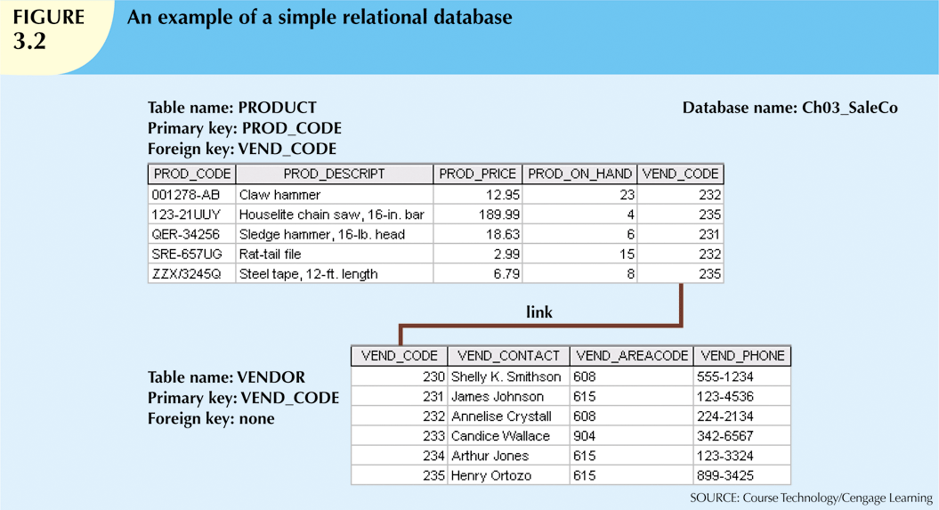

Slide 19
Types of Keys (cont’d.)
Foreign key (FK)
An attribute whose values match primary key values in the related table
Referential integrity
FK contains a value that refers to an existing valid tuple (row) in another relation
Every entry in VEND_CODE in the PRODUCT table has either a null or a valid value in VEND_CODE in the VENDOR table
Secondary key
Key used strictly for data retrieval purposes
lookup customer by last name and phone number when customer number is not known
may not return unique results – lookup by last name and city

Slide 20
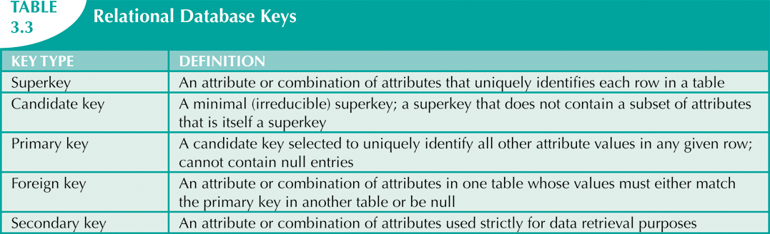

Slide 21
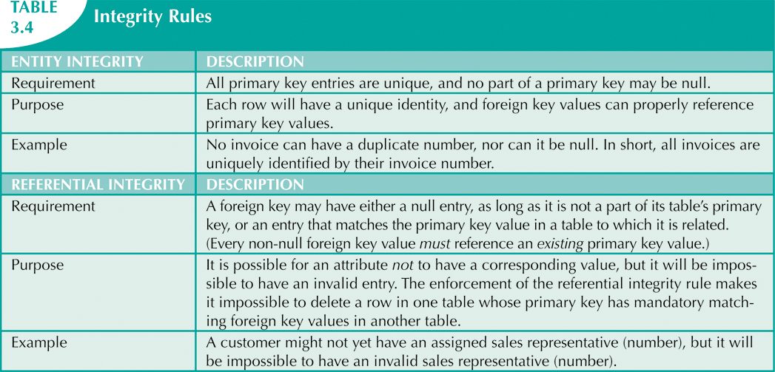
Integrity Rules
Many RDBMs enforce integrity rules automatically
Safer to ensure that application design conforms to entity and referential integrity rules

Slide 22
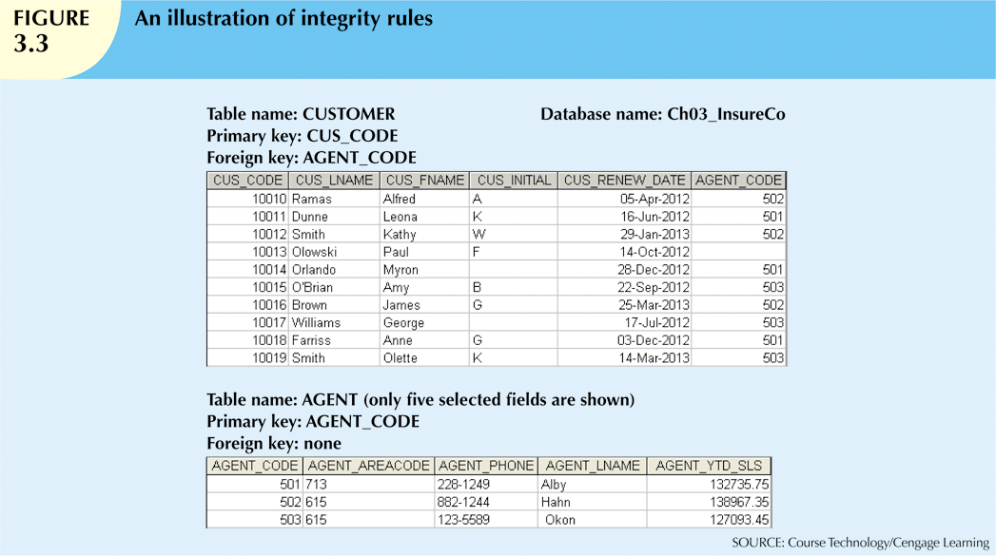
Can use flag (see next slide)

Slide 23

Integrity Rules
Designers use flags to avoid nulls
Flags indicate absence of some value
To replace NULL in CUSTOMER table, AGENT table must have an entry of -99 in the AGENT_CODE field
Other rules
NOT NULL constraint for a column
UNIQUE constraint on a column

Slide 24
Relational Set Operators
Relational algebra
Defines theoretical way of manipulating table contents using relational operators
Use of relational algebra operators on existing relations produces new relations:
SELECT | UNION
PROJECT | DIFFERENCE
JOIN | PRODUCT
INTERSECT | DIVIDE

Slide 25
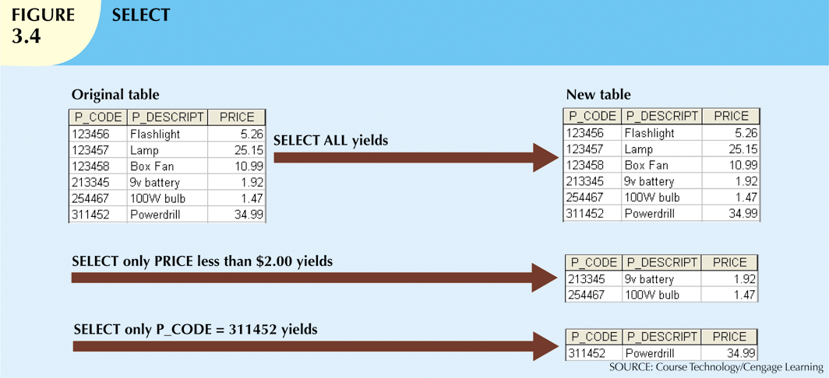
SELECT yields all values for all rows in a table that satisfy a given condition. Can also be used to list all rows in a table.
Yields a horizontal subset of a table

Slide 26
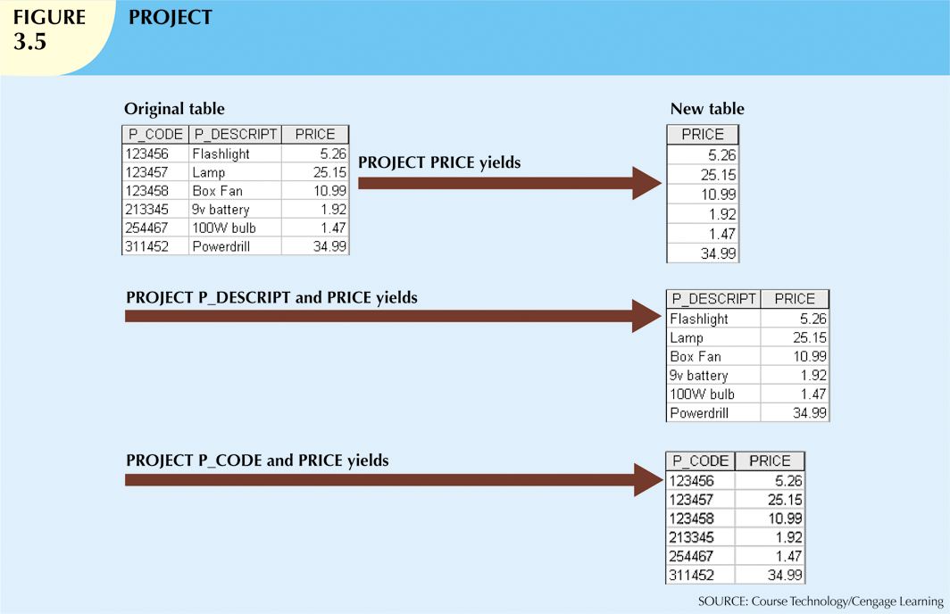
Yields all values for selected attributes – a vertical subset if a table

Slide 27
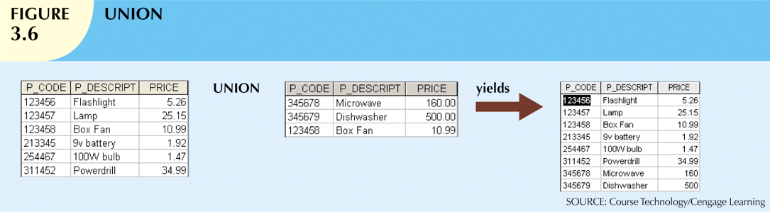
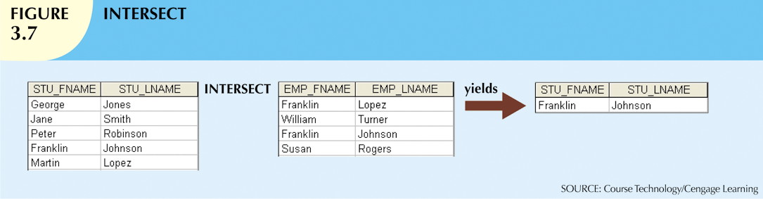
Combines all rows from two tables, excluding duplicate rows
The tables must have the same number of columns and their corresponding columns share the same or compatible domains: union-compatible
Yields only rows that appear in both tables
The tables must be union-compatible

Slide 28
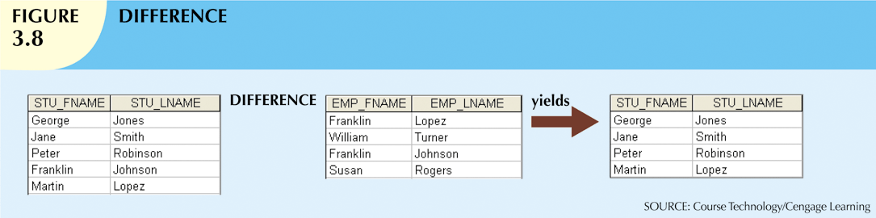
Yields all rows in one table that are not found in the other table
Subtracts one table from the other
The order of the tables is important
The tables are union-compatible

Slide 29
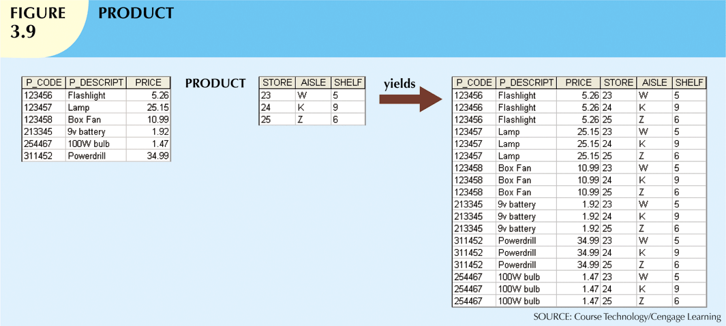
Yields all possible of rows from two tables
Also known as the Cartesian product
The tables must have the same attribute characteristics

Slide 30
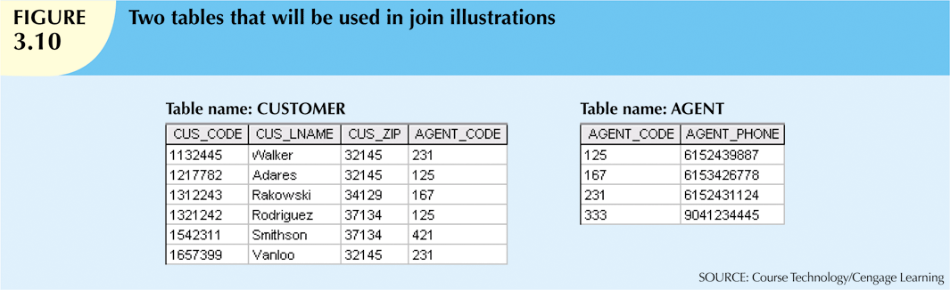
Relational Set Operators (cont’d.)
JOIN allows information to be combined from two or more tables
The real power behind the relational database, allowing the use of independent tables linked by common attributes

Slide 31
Relational Set Operators (cont’d.)
Natural join
Links tables by selecting rows with common values in common attributes (join columns)
First a PRODUCT of the tables is created
Second, a SELECT is performed on the above output to yield only the rows for which the AGENT_CODE values are equal
The common columns are referred to as join columns
A PROJECT is performed on the results in the second step to yield a single copy of each attribute, thereby eliminating duplicate columns

Slide 32
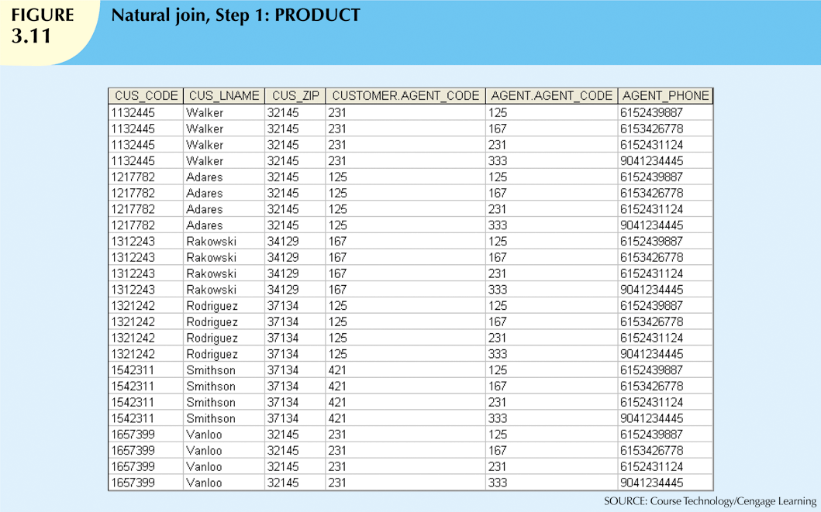

Slide 33
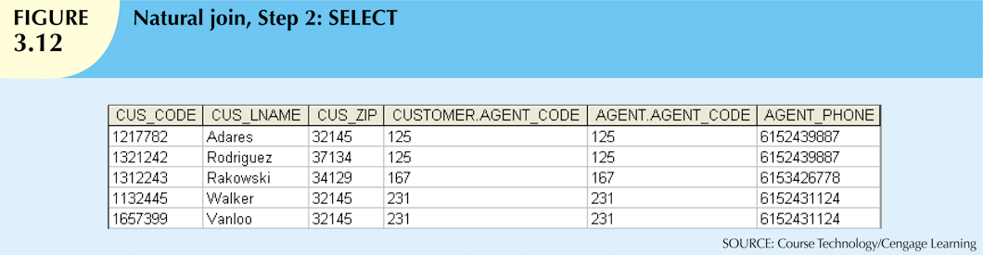
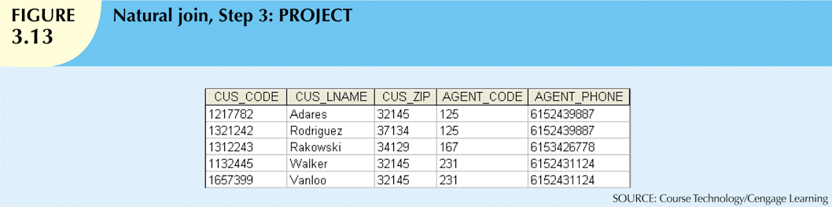
Note that AGENT_CODE 421 nor the customer with last name of Smithson is included as 421 does not match any emtry in the AGENT table

Slide 34
Relational Set Operators (cont’d.)
Equijoin
Links tables on the basis of an equality condition that compares specified columns
Does not eliminate duplicate columns
Join criteria must be explicitly defined
Theta join
A comparison operator other than equal is used
Inner join
Only returns matched records from the tables that are being joined
Natural join, equijoin and theta join are inner joins

Slide 35
Relational Set Operators (cont’d.)
Outer join
Matched pairs are retained, and any unmatched values in other table are left null
Returns all matched records (as an inner join) but returns the unmatched records from one of the tables
Useful in determining what values in related tables cause referential integrity problems
Left outer join
Yields all of the rows in the CUSTOMER table
Including those that do not have a matching value in the AGENT table
Right outer join
Yields all of the rows in the AGENT table
Including those that do not have matching values in the CUSTOMER table

Slide 36
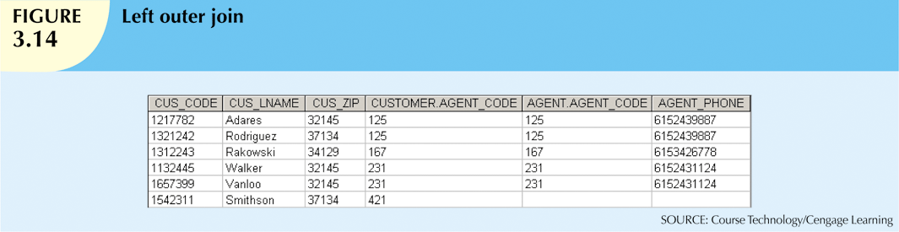
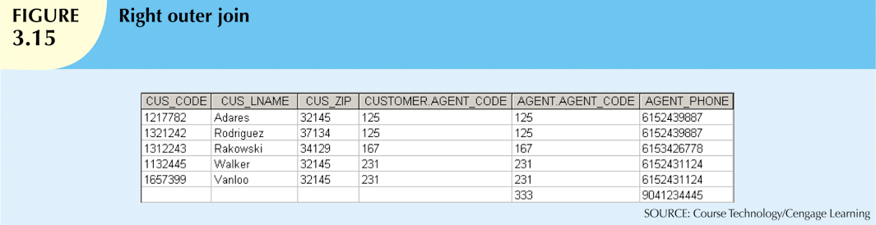
Relational Set Operators (cont’d.)
Yields all the rows in CUSTOMER including those that do not have a matching value in the AGENT
Yields all the rows in AGENT including those that do not have a matching value in the CUSTOMER

Slide 37
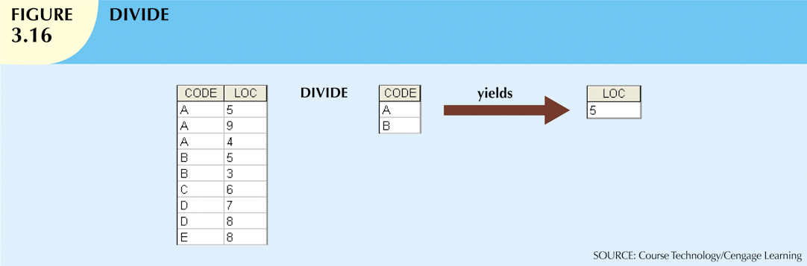
Relational Set Operators (cont’d.)
DIVIDE
Uses one 2-column table as the dividend and one single-column table as the divisor
The output is a single column that contains all values from the second column of the dividend (LOC) that ate associated with every row in the divisor

Slide 38
The Data Dictionary and System Catalog
Data dictionary
Provides detailed accounting of all tables found within the user/designer-created database
Contains (at least) all the attribute names and characteristics for each table in the system
Contains metadata: data about data
System catalog
Contains metadata
Detailed system data dictionary that describes all objects within the database
Data about table names, table’s creator, creation date, number of columns in each table, data type of each column, index filenames, index creators, authorized users and access privileges

Slide 39
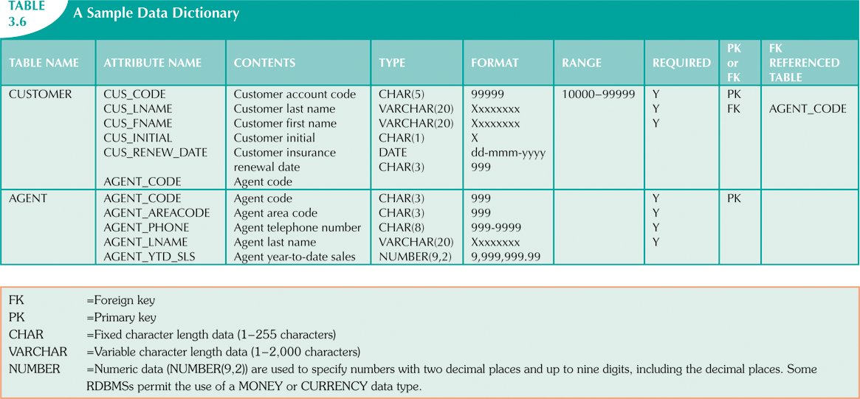

Slide 40
The Data Dictionary and System Catalog
Homonym
Indicates the use of the same name to label different attributes
Use C_NAME in a CUSTOMER table for customer name and in a CONSULTANT table for consultant name
Synonym
Opposite of a homonym
Indicates the use of different names to describe the same attribute e.g., CAR and AUTO

Slide 41
Relationships within the Relational Database
1:M relationship
Relational modeling ideal
Should be the norm in any relational database design
1:1 relationship
Should be rare in any relational database design
M:N relationships
Cannot be implemented as such in the relational model
M:N relationships can be changed into 1:M relationships

Slide 42
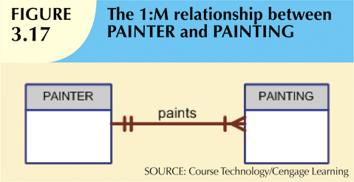
The 1:M Relationship
Relational database norm
Found in any database environment

Slide 43
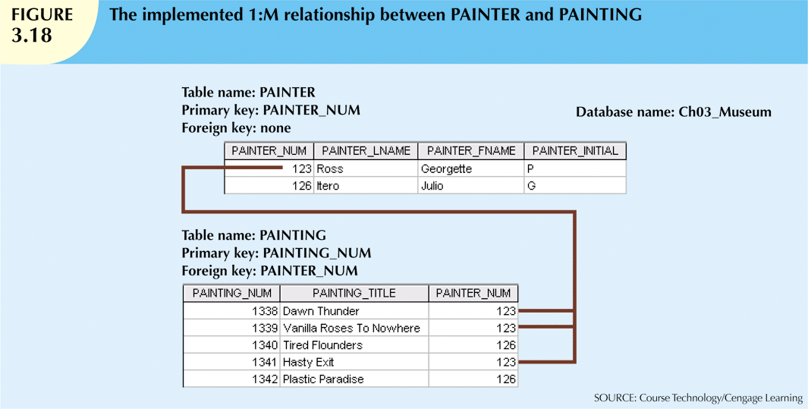
PK of the “1” side is put into the “many” side as a column

Slide 44

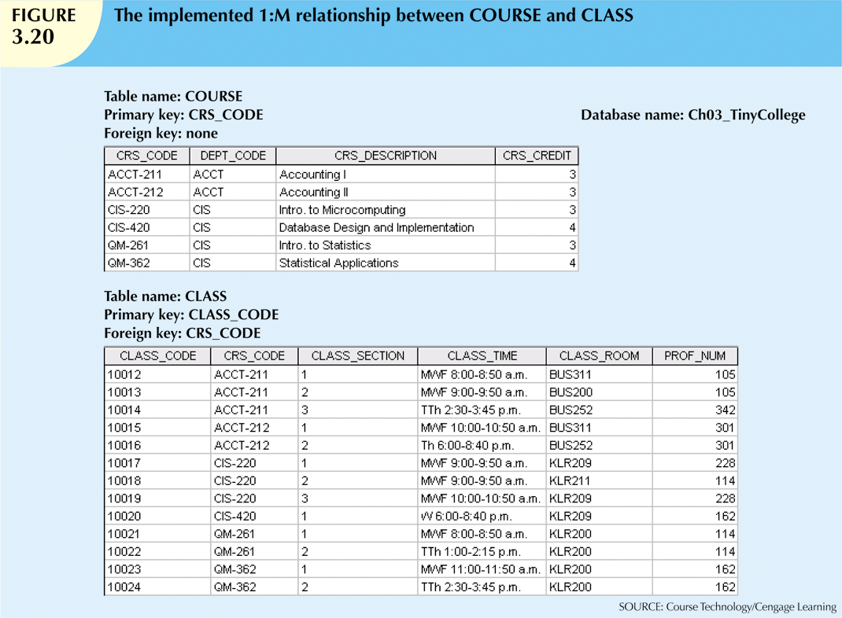
The composite key CRS_CODE and CLASS_SECTION is a candidate key as together they uniquely identify each row

Slide 45
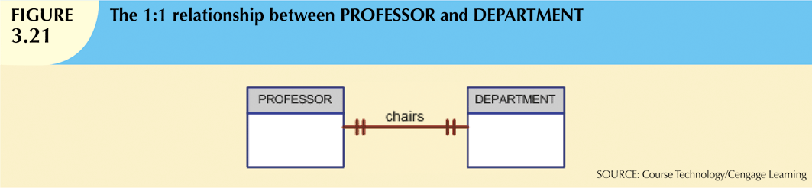
The 1:1 Relationship
One entity related to only one other entity, and vice versa
Sometimes means that entity components were not defined properly
Could indicate that two entities actually belong in the same table
Certain conditions absolutely require their use

Slide 46
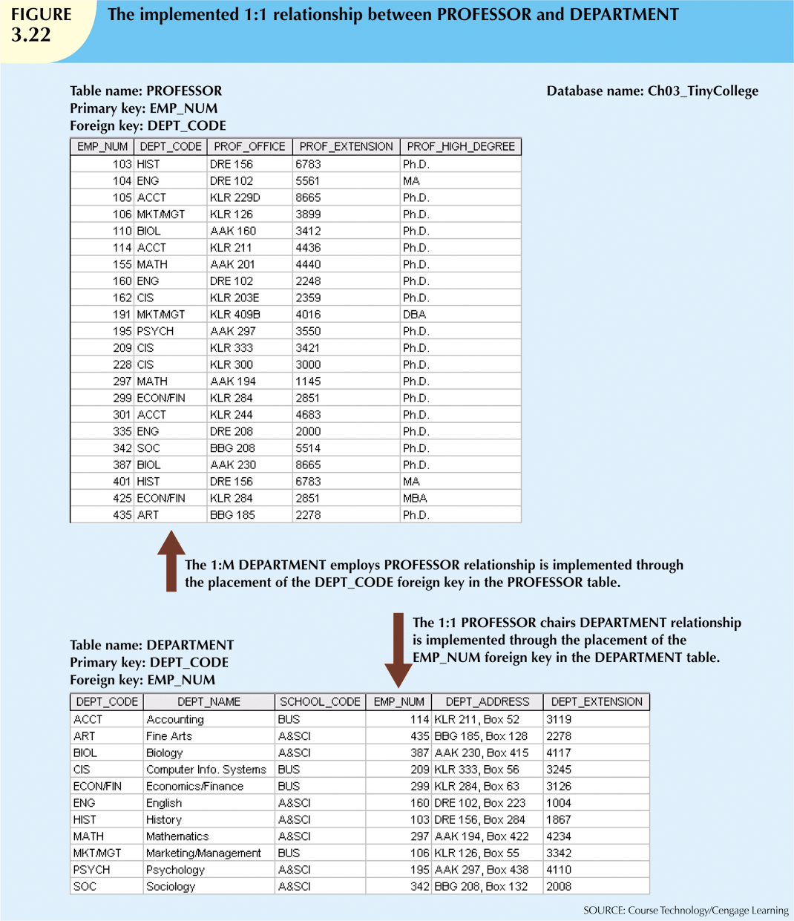

Slide 47
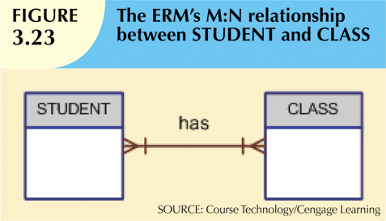
The M:N Relationship
Implemented by breaking it up to produce a set of 1:M relationships
Avoid problems inherent to M:N relationship by creating a composite entity
Includes as foreign keys the primary keys of tables to be linked

Slide 48
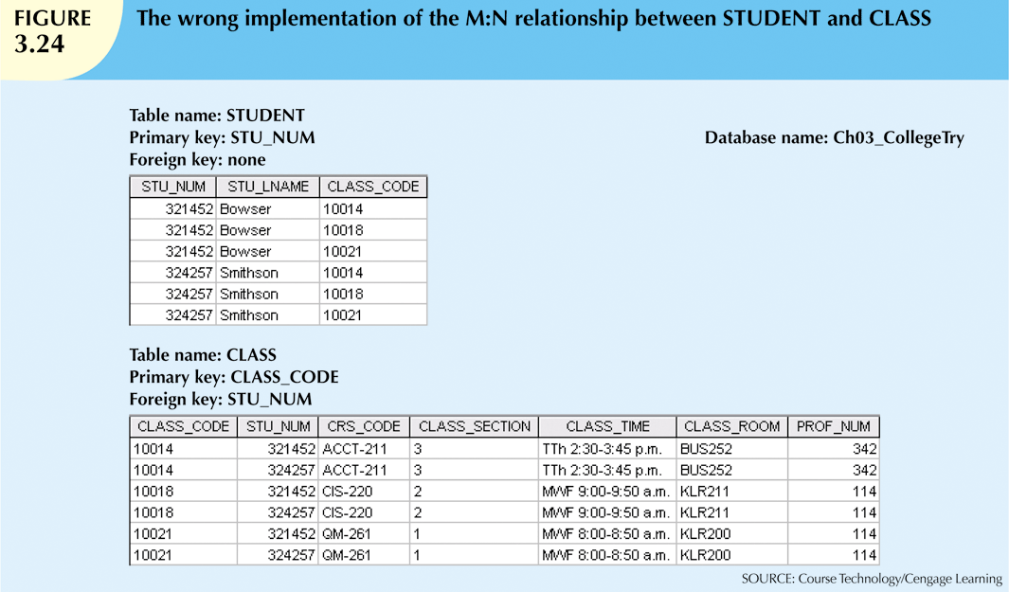
The M:N Relationship
Why not create the tables as below?
Redundancies:
STU_NUM values occur multiple times in the STUDENT table. In the real-world, there would be more student information that would be repeated (address, phone, etc)
CLASS_CODE also redundant in CLASS table

Slide 49

The M:N Relationship
Instead, create a composite entity ENROLL which minimally contains the PKs of both STUDENT and CLASS or uses a new, single-attribute key as the PK
AKA as an entity bridge or linking table
Will generally contain other relevant information such as grade earned

Slide 50
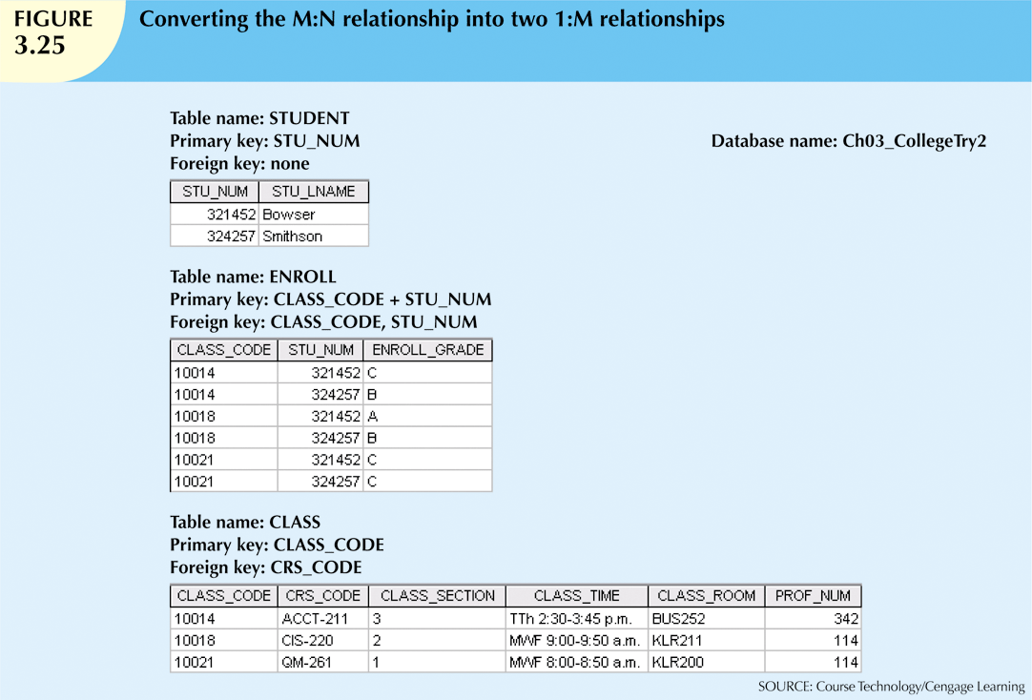
ENROLL contains multiple occurrences of the FK values, but those controlled redundancies won’t cause anomalies as long as referential integrity is enforced

Slide 51
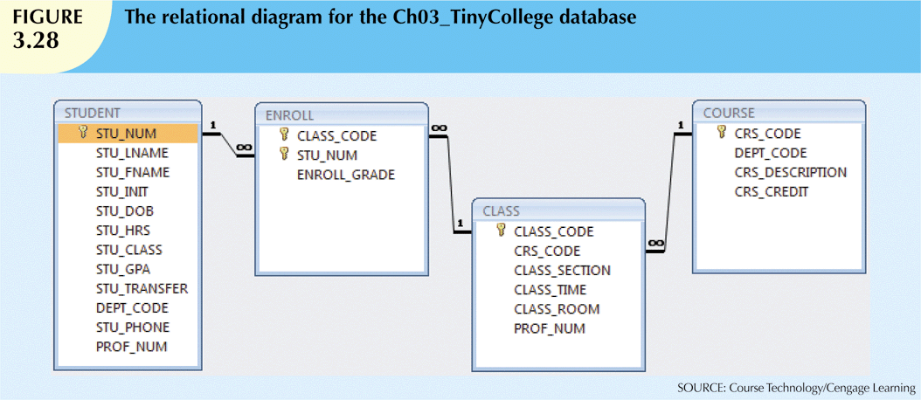

Slide 52
Data Redundancy Revisited
Data redundancy leads to data anomalies
Can destroy the effectiveness of the database
Foreign keys
Control data redundancies by using common attributes shared by tables
Crucial to exercising data redundancy control
Minimize data redundancies, do not eliminate them
Sometimes, data redundancy is necessary
Ensure transaction speed and/or information requirements; using relational algebra to generate the information can make the system elegant but impractical

Slide 53
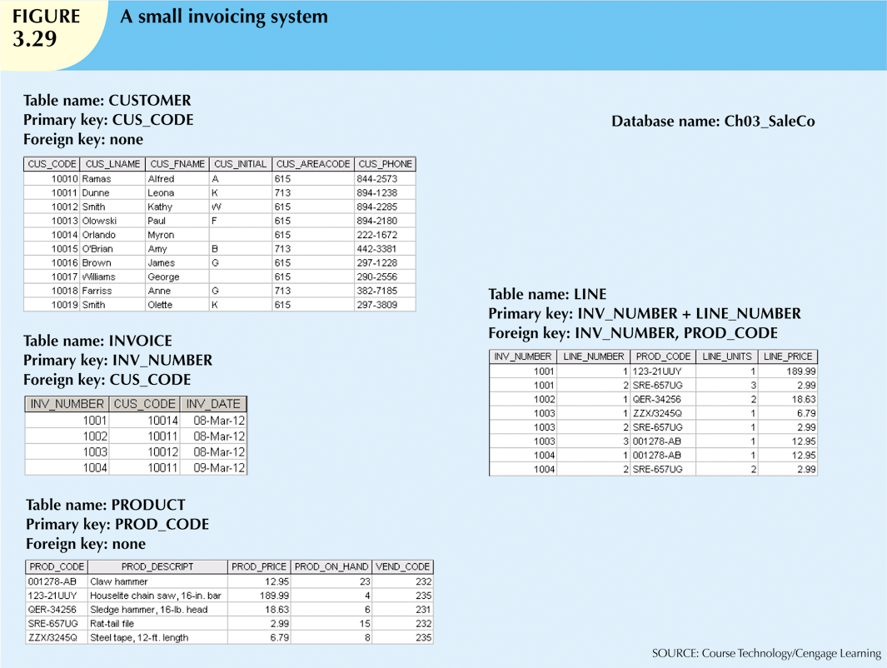
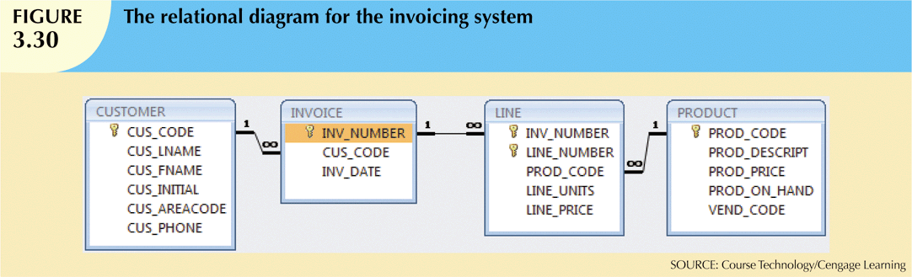
LINE_PRICE is needed, despite PROD_PRICE because the price changes over time and we need historical accuracy
INV_NUMBER and PROD_CODE could serve as a PK for LINE but LINE_NUMBER was added to keep track of the order the data were entered and serve as a reference for customer inquiries

Slide 54
Indexes
Orderly arrangement to logically access rows in a table so all records won’t be searched to find the one you are looking for
Index key
Index’s reference point
Points to data location identified by the key
Unique index
Index in which the index key can have only one pointer value (row) associated with it
Each index is associated with only one table

Slide 55
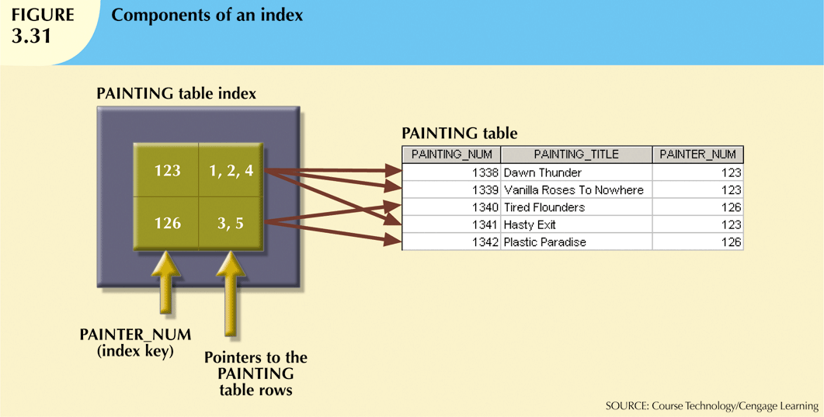
To look up all the paintings for a specific PAINTER_NUM, the index shows you exactly which records to look at

Slide 56
Codd’s Relational Database Rules
In 1985, Codd published a list of 12 rules to define a relational database system
Products marketed as “relational” that did not meet minimum relational standards
Even dominant database vendors do not fully support all 12 rules

